Slide 1
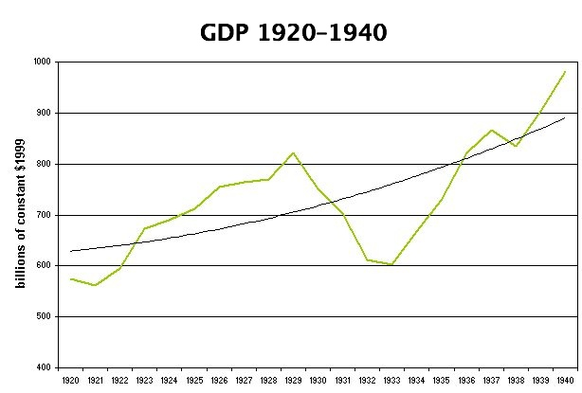
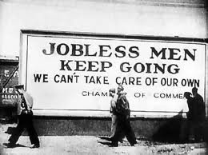
Classical Theory of Employment vs Keynesian Theory of Employment

Slide 2
Introduction
John Maynard Keynes’ The General Theory of Employment, Interest and Money (1936) has significant contribution to the Macroeconomics.
Keynes theory has a frontal attack on classical thought on determination of output and full employment concept. The primary purposes of the theory is to explain what explains volume of employment at any time.
Some the noted classical economists include Adam Smith, David Ricardo, J.S. Mill, A. Marshall and Pigou.
Keynesian theory influences the macroeconomic theory as classicals failed to explain the causes of Great depression (1929-1941).

Slide 3
Who is the devil ??????
Debt is seen as one of the causes of the Great Depression. (What follows relates to the USA).
Ben Bernanke, the current chairman of the U.S. Federal Reserve Bank, have revived the debt-deflation view of the Great Depression originated by Arthur Cecil Pigou and Irving Fisher: in the 1920s, American consumers and businesses relied on cheap credit, the former to purchase consumer goods such as automobiles and furniture and the latter for capital investment to increase production. This fueled strong short-term growth but created consumer and commercial debt. People and businesses who were deeply in debt when price deflation occurred or demand for their product decreased often risked default. Many drastically cut current spending to keep up time payments, thus lowering demand for new products. Businesses began to fail as construction work and factory orders plunged.

Slide 4
Classical Theory: Assumptions
There is the existence of full employment without inflations.
Full employment of labour and resources. Any lapses was defended
as there is always a tendency toward the full employment. Any disturbances in the stable equibm with F.E will be corrected by the laissez-faire . Keynes consider L.F. as the main reason behind the fluctuating level of employment. Classical theory never explains the factors affecting the volume of employment.
There is perfect competition in labour and product markets.
There is a closed laissez faire capitalist economy without foreign trade.
Labour is homogenous.
Total output of the economy is divided between consumption and Investment expenditures.
The quantity of money is given.
Wage and prices are flexible.
Money wage and Real wage are directly related and proportional.
Capital stock and technology are given in the short run.
Say’s Law.

Slide 5
Wages & Employment
The demands for all goods together equals supply of all goods.
There may be temporary excess supply of a particular commodity say X, but general over supply of X, Y and Z together over the demand of X, Y and Z is impossible.
Over supply of X may be because of its higher price. The solution is price reduction by cost cutting and the classical economists suggested wage cut in that industry/ Firm .

Slide 6
Wages & Employment
The cost cut via wage reduction will decrease the price – demand will pickup, which increase the demand of labour and the unemployment that was prevailing due to temporary over production will evaporate.
Thus classical economists believed that wage rigidity or other market imperfections are the cause of unemployment.

Slide 7
Frictional Unemployment and the Natural Rate of Unemployment
Taken literally, the classical model implies that there is no involuntary unemployment → everyone who wants to work is employed
In reality there is some unemployment due to frictions in the labor market (Ex. Someone is always moving and looking for a new job)
The unemployment rate associated with the full employment level of output is the natural rate of unemployment
Natural rate of unemployment is the rate of unemployment arising from normal labor market frictions that exist when the labor market is in equilibrium

Slide 8
Explanation with AS/AD
Aggregate supply curve describes, for each given price level, the quantity of output firms are willing to supply
Upward sloping since firms are willing to supply more output at higher prices
Aggregate demand curve shows the combinations of the price level and the level of output at which the goods and money markets are simultaneously in equilibrium
Downward sloping since higher prices reduce the value of the money supply, which reduces the demand for output
Intersection of AS and AD curves determines the equilibrium level of output and price level

Slide 9
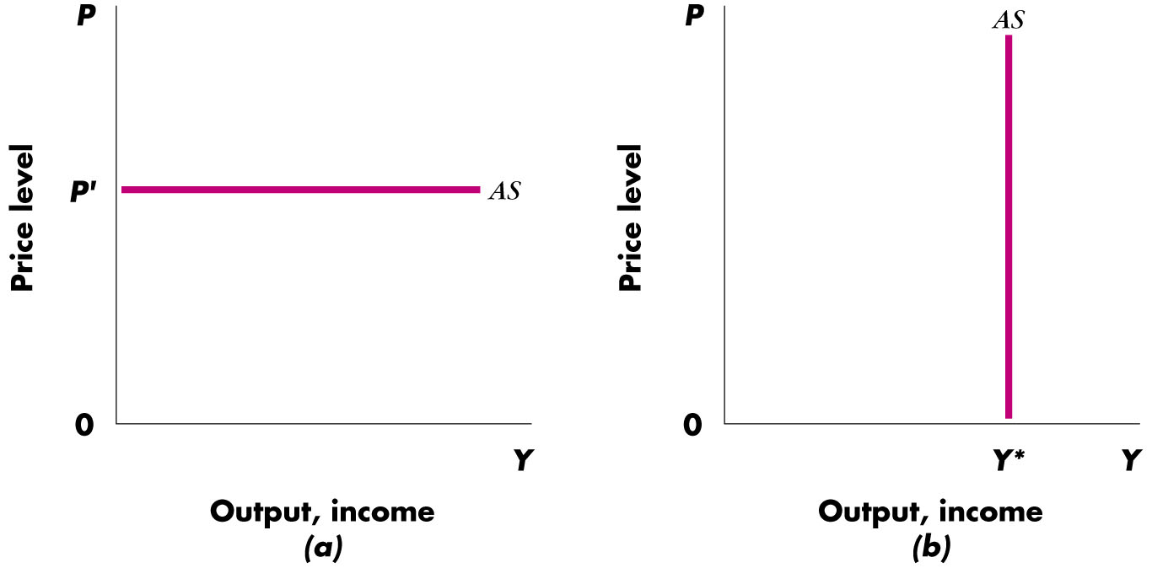
Classical supply curve (Short-run)
The classical supply curve is vertical, indicating that the same amount of goods will be supplied, regardless of price (Figure-b).
Based upon the assumption that the labor market is in equilibrium with full employment of the labor force
The level of output corresponding to full employment of the labor force = potential GDP, Y*

Slide 10
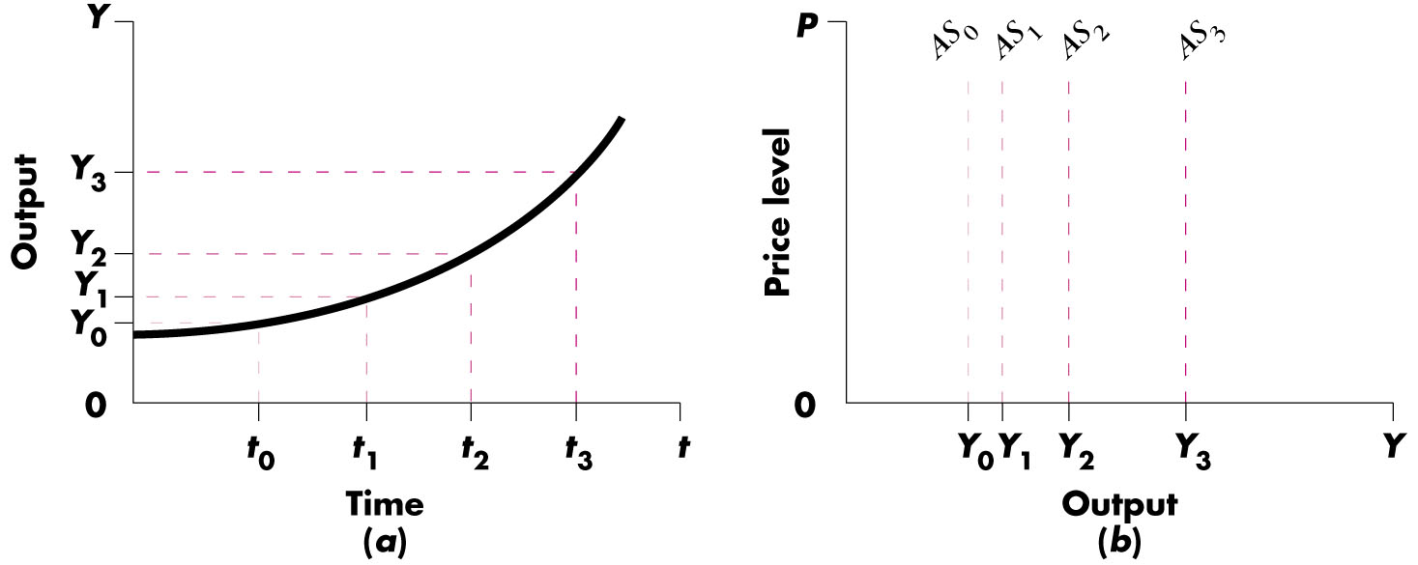
Supply curve (Long-run)
Y* grows over time as the economy accumulates resources and technology improves → AS curve moves to the right
Y* is “exogenous with respect to the price level”
illustrated as a vertical line since graphed in terms of the price level

Slide 11
Keynesian supply curve (Short-run)
The Keynesian supply curve is horizontal, indicating firms will supply whatever amount of goods is demanded at the existing price level.
Since unemployment exists, firms can obtain any amount of labor at the going wage rate
Since average cost of production does not change as output changes, firms willing to supply as much as is demanded at the existing price level
Intellectual genesis of the Keynesian AS curve is found in the Great Depression, when it seemed firms could increase production without increasing P by putting idle K and N to work
Additionally, prices are viewed as “sticky” in the short run, or firms are reluctant to change prices and wages when demand shifts
Instead firms increase/decrease output in response to demand shift = flat AS curve in the short run

Slide 12
To conclude on AS/AD Models
In simple Keynesian theory in short run price is determined by AS and out put by AD..
In simple classical theory price is determined by AD and output level of AS.

Slide 13
Introduction to classical theory
J.B Say (1797-1832) was a classical French economist, who was a follower of Adam smith, he was of the view that, when a product is created in the economy, it creates an immediate demand in the economy equals to its own value. As a result of that demand equals to supply.
This conclusion came to be known as Say`s Law of Market. For example one person produces wheat, while other produce cloth they will exchange the products with one another so nothing remain unsold and no producer will face losses, as a result there will be no unemployment.

Slide 14
Continued……
The simple statement of the Say`s Law is “ supply creates its own demand”.
According to this, whatever is produced in a free enterprise economy is automatically demanded and over a long period of time when a supply of a good and services increases, the demand for them also increases and vice versa.
Explanation of classical model in various markets
Classical model is explained with the help of four markets of economy.
Money market
Good market
Credit market
Labor market

Slide 15
J.B say Law of Market
1 J.B say Law in Goods Market
In barter economy goods produced either for their own use or to exchange for other good. So concept of aggregate demand and aggregate supply works and process of value equalization starts till the equilibrium is settled in market.
Supply creates its own demand, means whatever is produced in barter economy is sold out”
Hence no possibility of over production and no unemployment in economy.

Slide 16
Labor market in classical model
In this market we will discuss supply of labor and demand for labor.
Furthermore demand for labor will be discussed from the point of view of single firm as well from economy point of view.
So demand for labor is the demand which depends on MPL.
Inverse relationship exist between demand for labor and MPL.
It means that at higher real wage rate(w*) the demand for labor will be low, while at lower real wage rate the demand for labor will be high
This relationship is shown in this graph.
MPL
MPL> W*2
W*3
E
MPL=W*2
W*2
MPL< W*
W*1
MPL
o
L
L1
L2
L3

Slide 17
A firm will not employ OL1 units of labor as here MPL >W2, as a result it will increase the employment of labor.
Similarly a firm will not be interested to demand OL3 units of labor, as here MPL < W2.
Thus a firm will be in equilibrium at OL2 where MPL= W2

Slide 18
Labor market in classical model (cont….)
Aggregate demand for labor
Aggregate demand means demand for labor by all firms.
Negative slope, ADL shows different amounts of labor at different wage rates
W/P
W*
1
ADL =f(W*)
W*
0
DL
0
DL1
DL2
DL

Slide 19
Supply of labor
The individual supply of labor shows how much work an individual is willing to offer at different wage rate.
Wage rate is positive related with supply of labor.
Market supply or aggregate supply means all individual workers willing and able to work.
W*
ASL= f(W/P)
W*3
W*2
W*1
0
SL1
SL2
SL3
ASL

Slide 20
Equilibrium in labor market
Equilibrium in labor market is attain at W/P, where DL=SL
If wage rate increase due to any reason, then this increase will cause unemployment for short period, because firms will lay off some employees to cut down the extra cost. So according to classical economist there is self adjustment process in economy so again wage rate tends to decrease and economy come back towards equilibrium.
Similarly if wage rate decreases, it will create an an excess demand for labor, this will lead to increase in wages and economy once again come towards equilibrium.

Slide 21
4 Credit market in classical model
According to classical economists at the level of full employment saving is equal to investment.
It is the rate of interest which equalizes the saving and investment.
Saving is increasing function of rate of interest while Investment is decreasing function of rate of interest.

Slide 22
Credit market in classical model (cont…)
If rate of interest increases from equilibrium rate of interest ,saving become greater than investment it shows surplus saving.
Credit market is in equilibrium at point “E” and rate of interest is i0.
S
S > I
A
B
i2
io
E
i1
P
Q
I > S
I
S=I

Slide 23
Credit market in classical model (cont…)
If rate of interest increases from equilibrium rate of interest ,saving become greater than investment it shows surplus saving.
Credit market is in equilibrium at point “E” and rate of interest is i0.

Slide 24
Similarly if rate of interest decreases than equilibrium rate of interest then investment become greater than saving.
This equality between saving and investment is automatic adjustment process and there is no need of Government intervention.
Market forces clears the market and there is full employment prevail in economy.

Slide 25
Keynes’s criticism of classical theory
Possibility of deficiency in Effective Demand According to Keynes the classical theory is unreal. In a competitive market it is not necessary that all income earned is automatically spent on consumption and investment. A part of income may be saved and may go to savings. So there may appear the deficiency in aggregate demand causing over production and unemployment in country.

Slide 26
Keynes’s criticism of classical theory (cont…)
2 Pigou`sView on wage cut Keynes criticizes Pigou`s view that a general cut in wage rate in times of depression is a cure for unemployment. Keynes is of the opinion that a general cut in wages reduces the aggregate demand for goods and deepens depression.

Slide 27
Keynes’s criticism of classical theory (cont…)
Not a general theory The say`s law assumes that micro economic analysis can profitably by applied to the economy as a whole. Keynes rejects this view and says that for the explanation of general theory of income and employment the macro economic analysis is required.

Slide 28
Keynes’s criticism of classical theory (cont…)
4 Saving and investment equality Keynes was never convinced of the classical version that rate of interest can equate saving and investment. According to him, it is the income and not the rate of interest which is the equilibrium force between saving and investment.

Slide 29
Keynes’s criticism of classical theory (cont…)
Element of Perfect competition Say`s assumes perfect competition in the economy. Keynes said that it is the imperfect competition which in practice prevails in the product and factor market. So therefore say`s law is not operative.

Slide 30
Keynes’s criticism of classical theory (cont…)
6 Laissez faire (free enterprise economy) Keynes pointed out the laissez faire economy has a natural tendency to fall into a slump and this situation can be remedied only through a state intervention in the form of public investment and other fiscal measures. Thus Keynes justified state intervention in contrast to view of classical.

Slide 31
The Methodological Flaws
Application of Partial equilibrium analysis to Macro issue
A general cut in wages will result reduction in demand and will not remove unemployment
Investment and consumption expenditure are complimentary till the economy is at less than full employment level but once full-employment is achieved the relationship is competitive

Slide 32
The Methodological Flaws
3. The Neutrality of Money is not a reasonable assumption . Money is not only medium of exchange and Standard of value but also function as store of value or a medium to store wealth . The people’s decision to hold more or less of their wealth in form of money , affects transactions thereby many other economic variables.

Slide 33
Practical Aspect
If at all wage cut solves unemployment ( though is theoretical incorrect ), it need to be done by decreasing real wages and not money wages. As Keynes put it
“ whilst workers will usually resists a reduction of money wages it is not their practice to withdraw their labour whenever there is rise in price of wage goods”

