Slide 1
Digital Thermodynamics
Smart Refrigerators will be able to tell you if it is consuming too much power or needs defrosting or you are opening it too often. For this the microprocessors in it must incorporate digital thermodynamics.

Slide 2
Property Charts
pV=nRT, R is the Universal Gas Constant, n the no of moles or n=m/M, where m is the mass and M is the Molecular weight.
Internal Energy and Enthalpy are
U= Cv T and H=Cp T with γ= Cp/Cv; Cp-Cv=R.
The above properties are needed for Thermodynamic analysis
With Ideal Gas Law a Calculator is sufficient.
But…

Slide 3
Z
Equation Solver is needed for gases which don’t obey Ideal Gas Law for whom
pV= ZnRT
For liquids, and liquids turning to vapour, the other properties which matter are Saturation Pressure, Saturation Temperature and Latent Heat of Vaporization and for these Z is never 1.
Z is called compressibility.

Slide 4
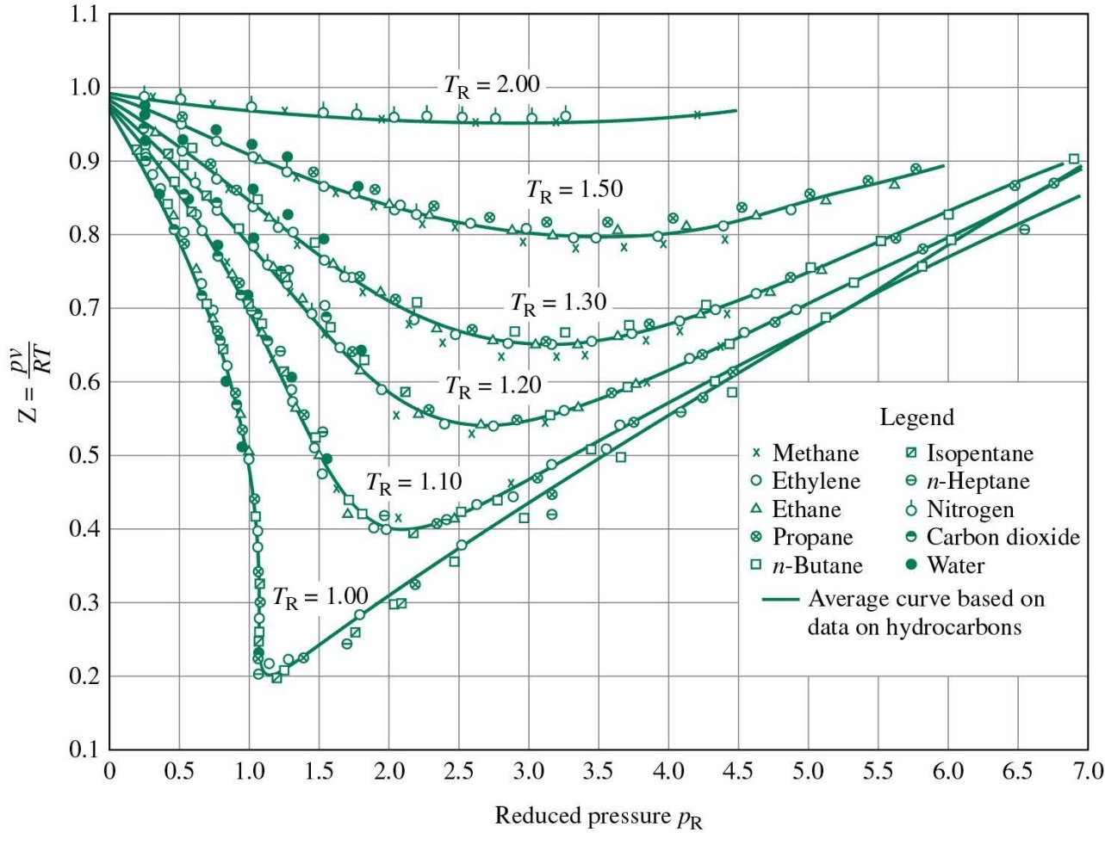
Compressibility
When is Z=1?

Slide 5
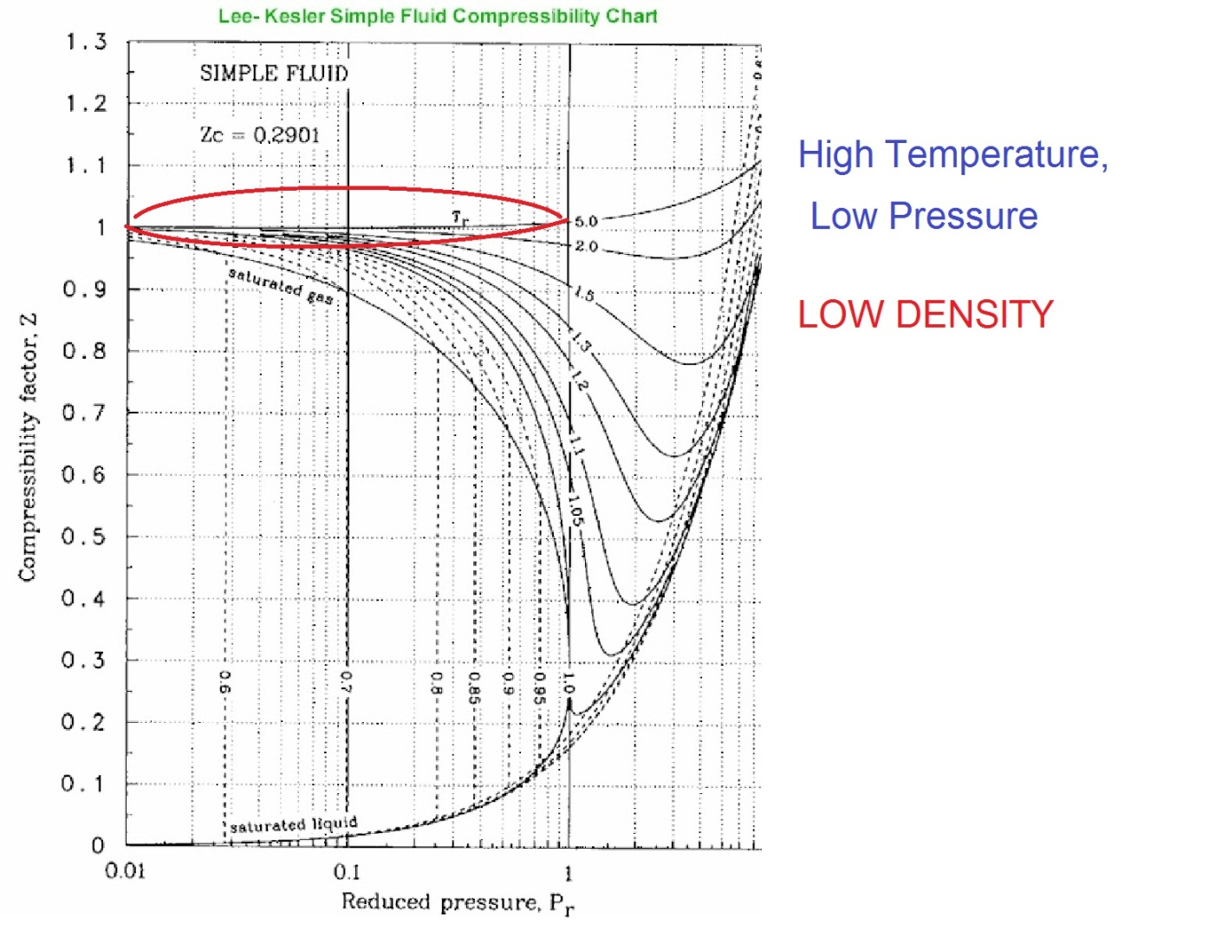
Z

Slide 6
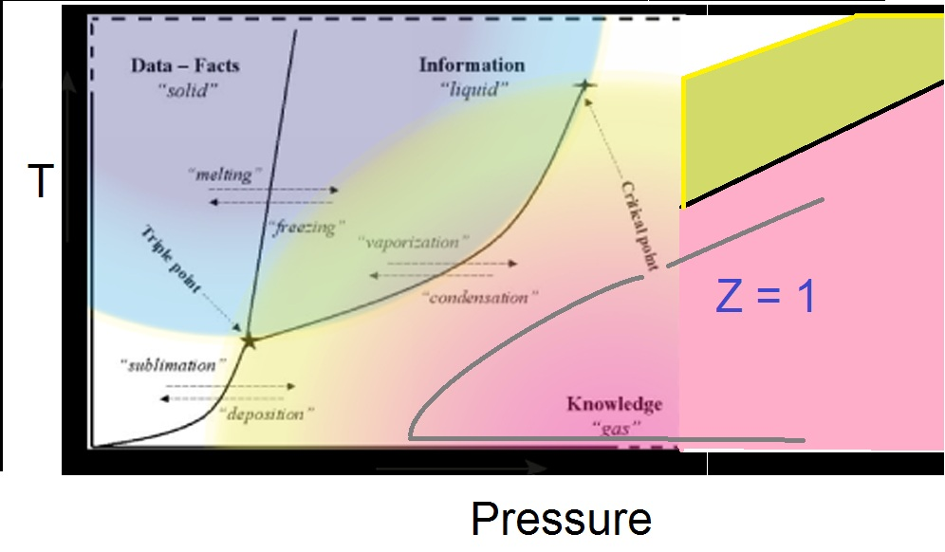
Z

Slide 7
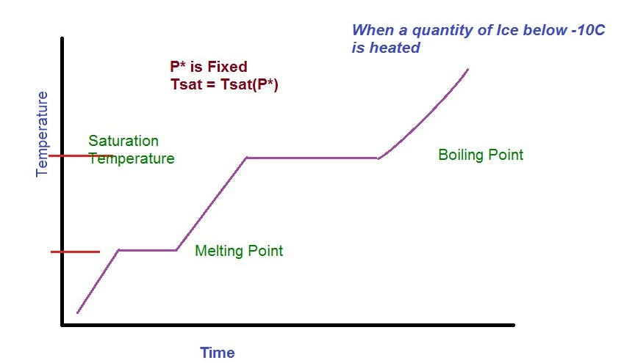
Saturation Temperature

Slide 8
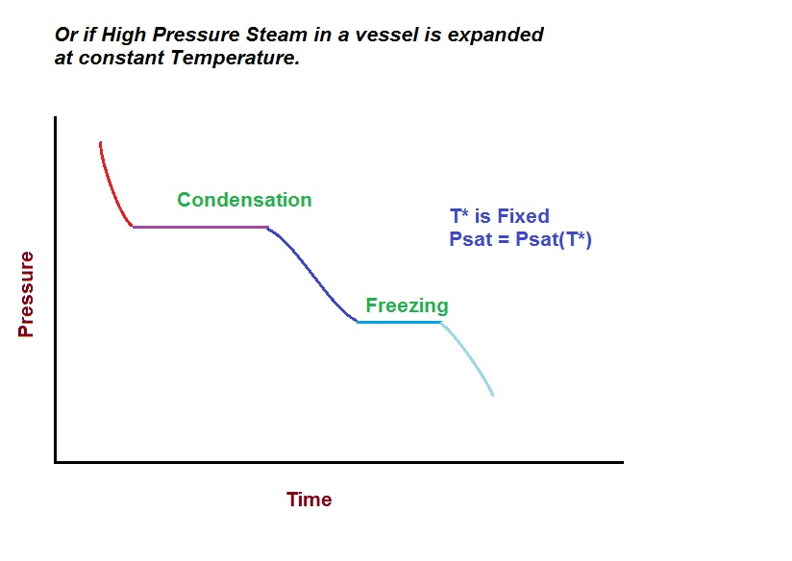
Saturation Pressure

Slide 9
Using Digital Info
Computation after Moore’Law: The invasion of semiconductor electronics brought calculators replacing slide rules in the 70s. In the next century, EES and like software have replaced property charts, such as Steam Tables, Psychrometric and other Property Charts.
Earlier all these properties had to be taken from charts for engineering calculations, now these are available at the click of a button from EES.
Soon we could get all computations and look up tables on line. The challenge is to make heat engines smart using such public data and is undertaken by those familiar with IT.
NO need to use calculator in Thermodynamics education anymore.
Computers with EES would give you immense power and flexibility to solve
any kind of complex thermodynamics problems

